Slide 1
DIFFERENTIATION
CONTENT
Differentiability
Differentiating Explicit Functions
Differentiating Parametric Functions
Differentiating Implicit Functions
Differentiating Inverse Trig Functions
Differentiating Logarithmic and Exponential Functions
Higher Order Derivatives
Practice Exercises

Slide 2
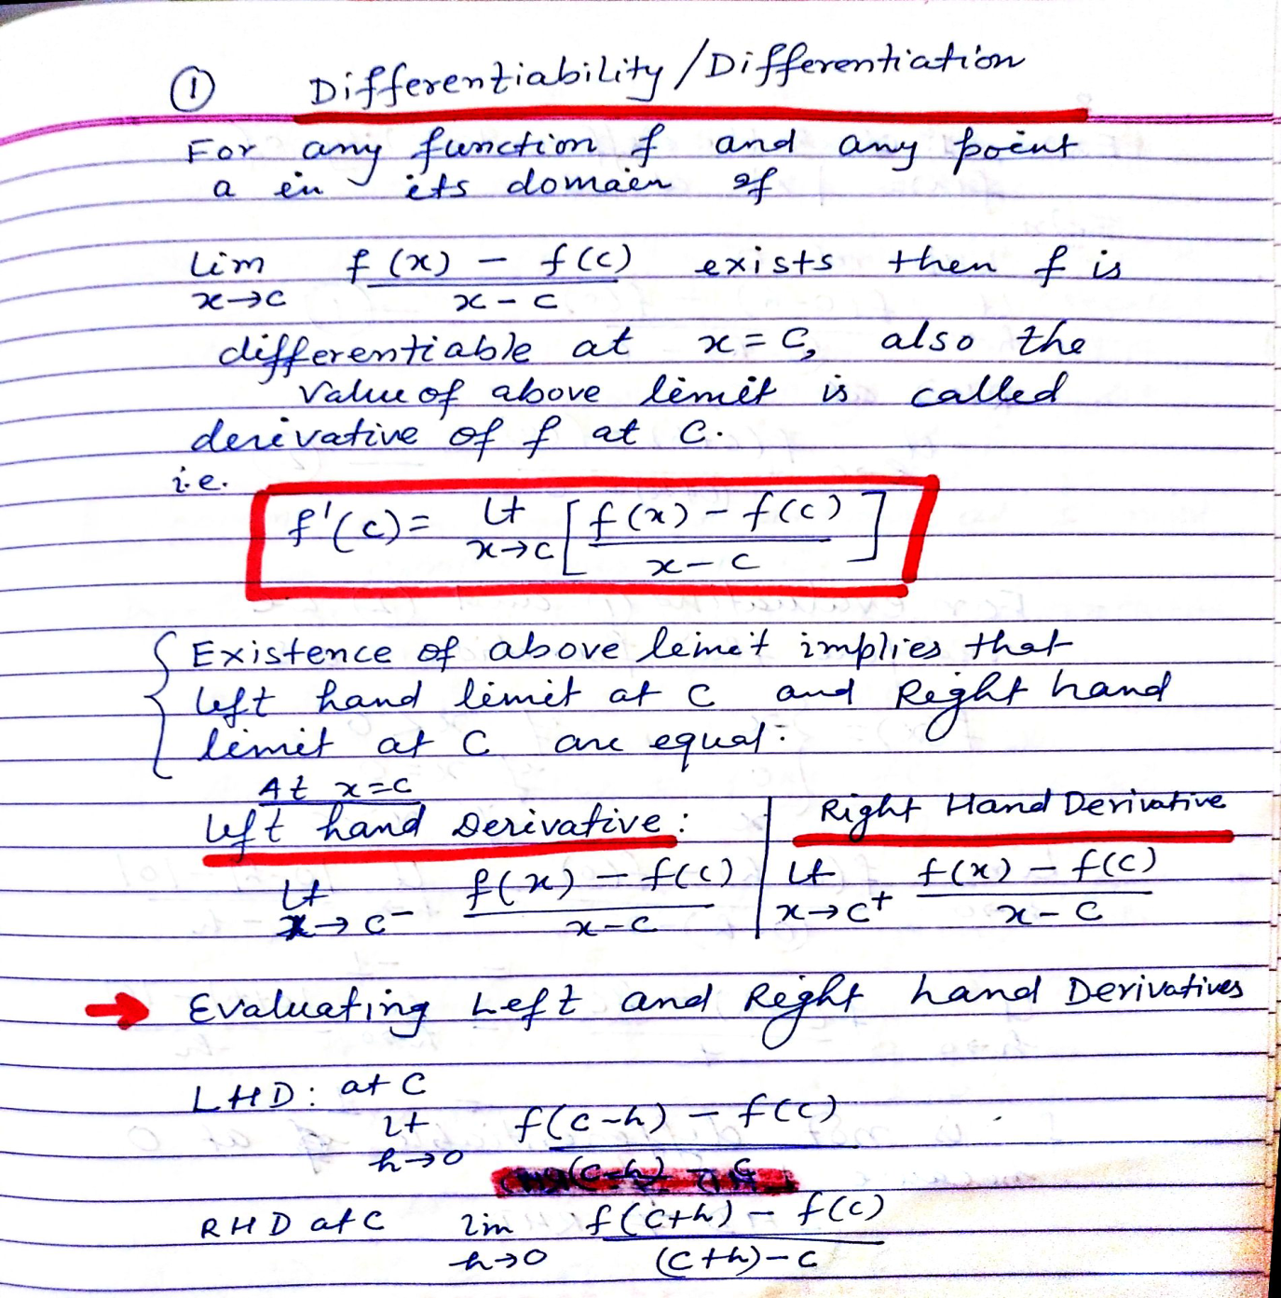

Slide 3
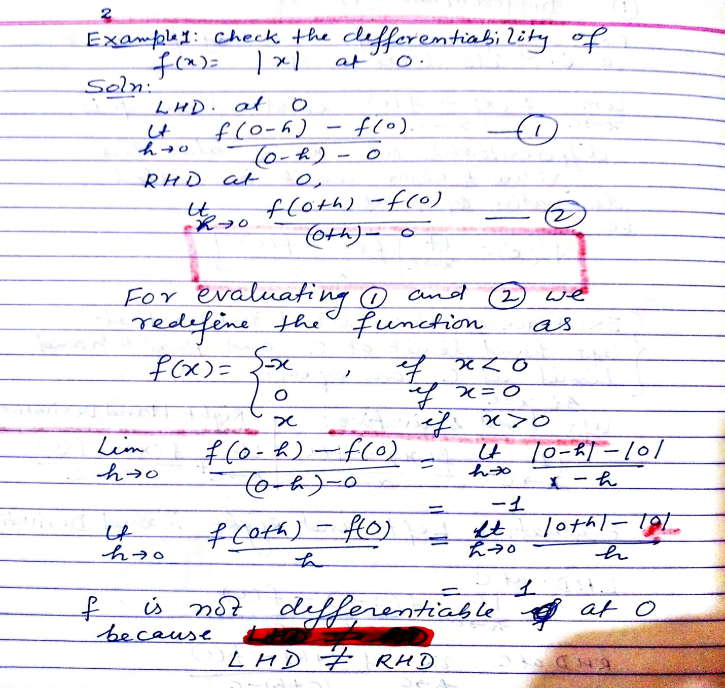

Slide 4
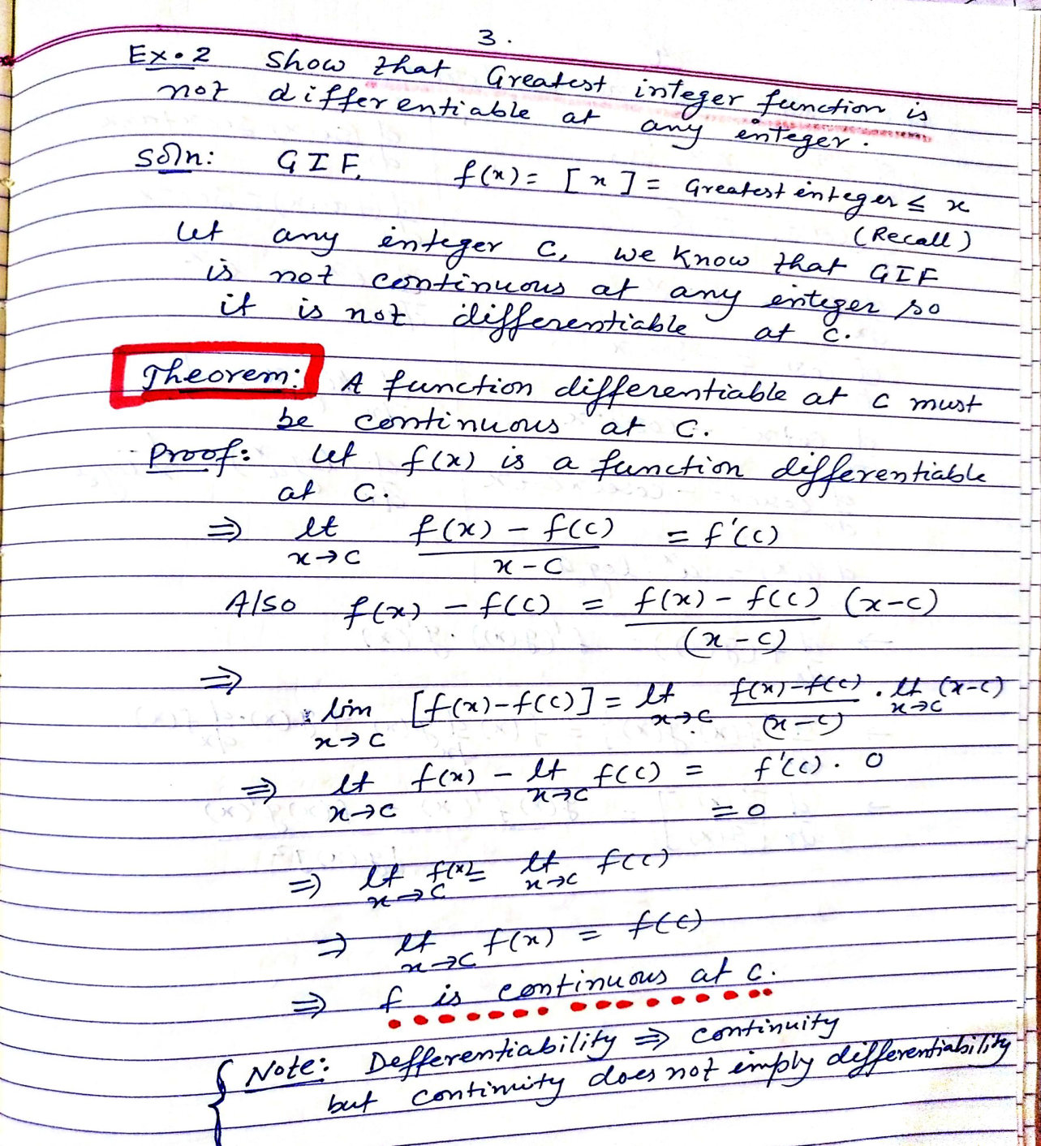

Slide 5
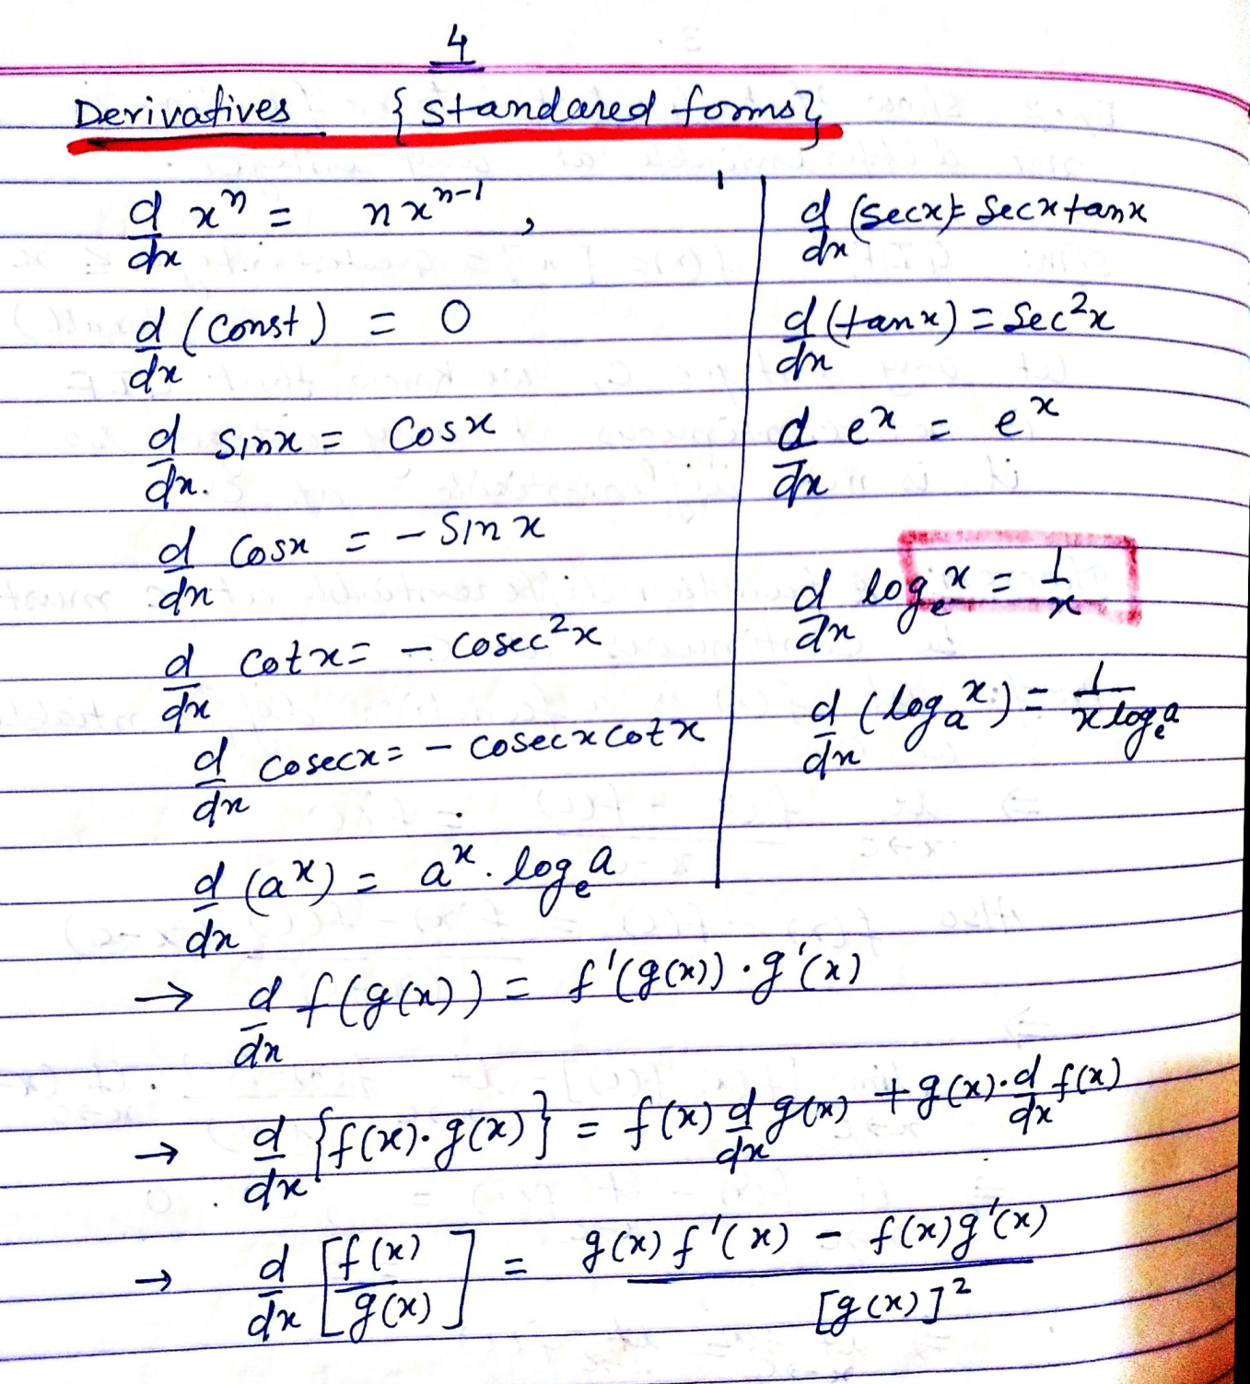

Slide 6
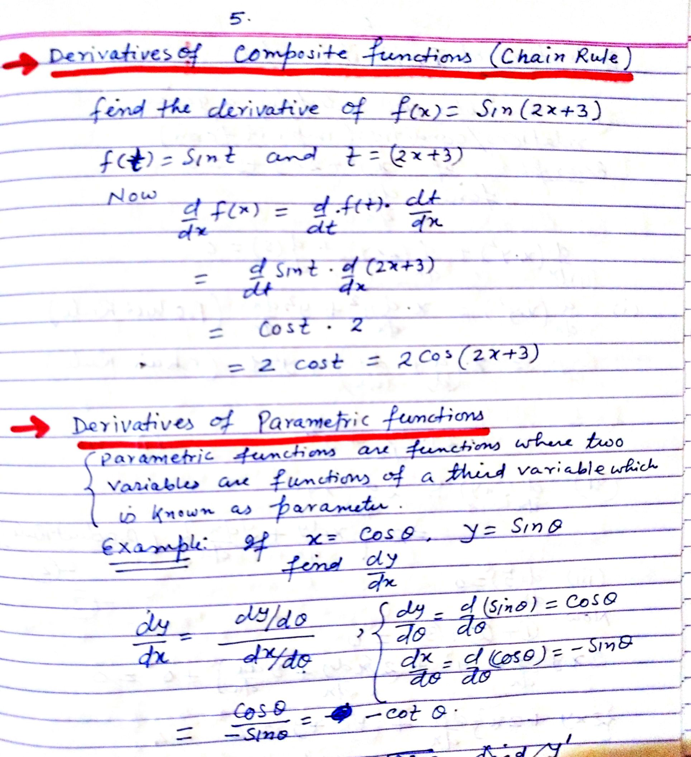

Slide 7
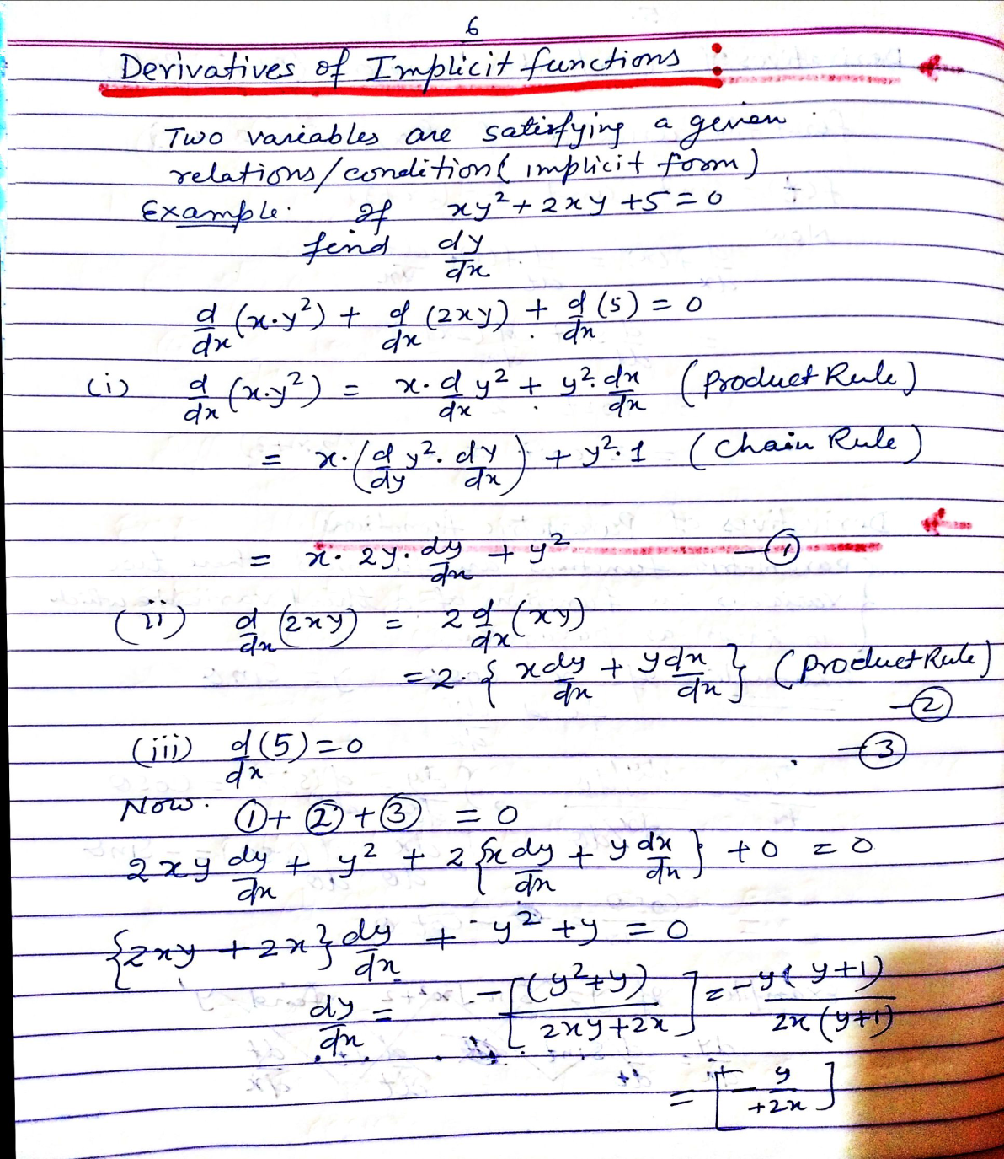

Slide 8
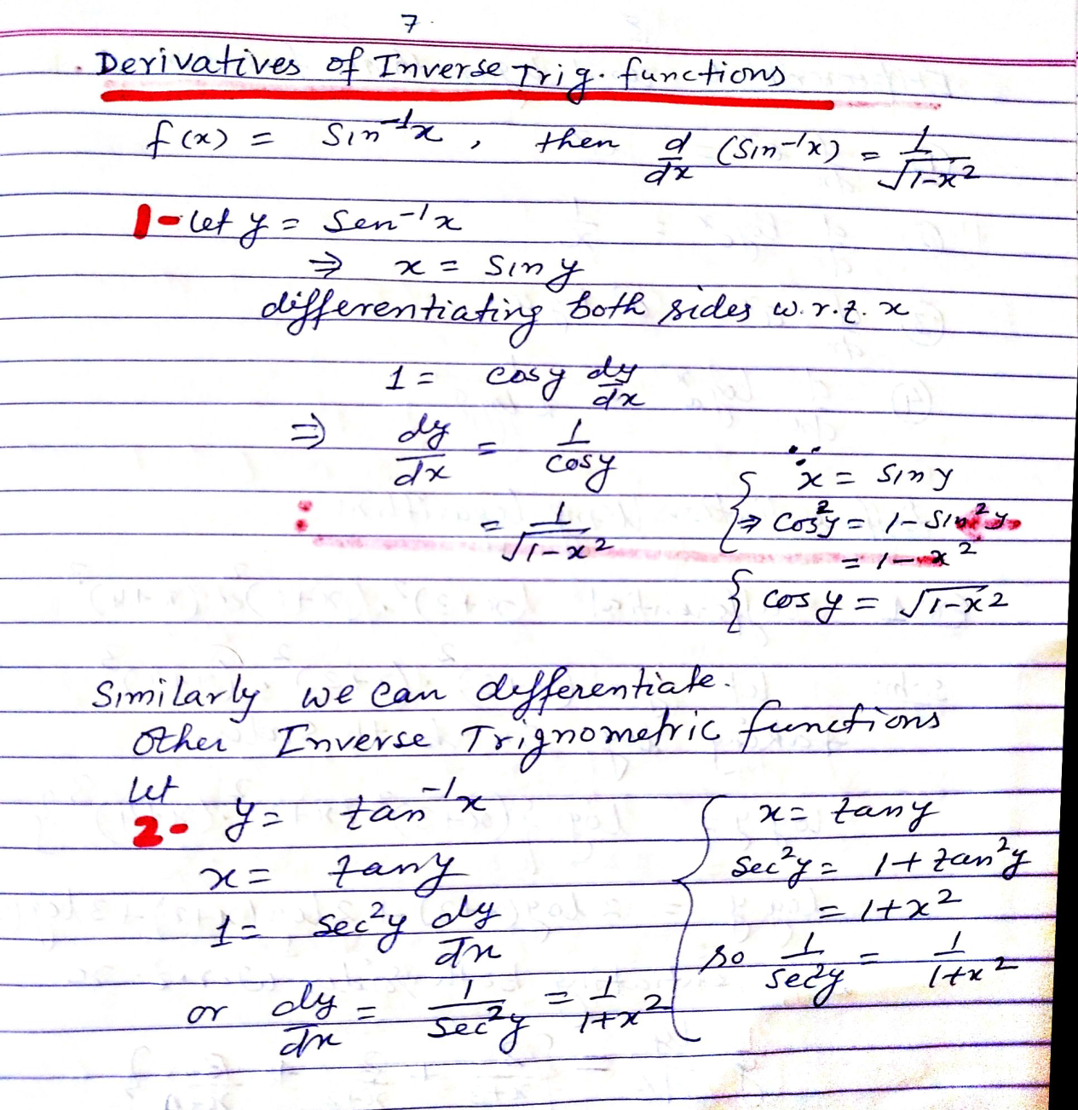

Slide 9
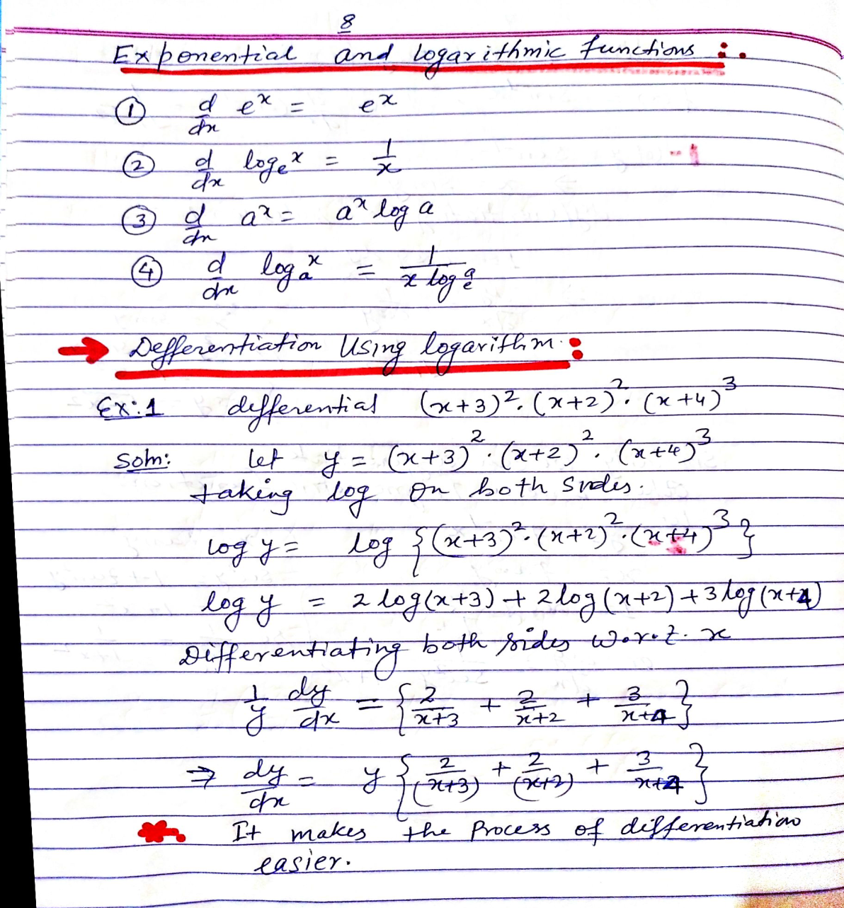

Slide 10
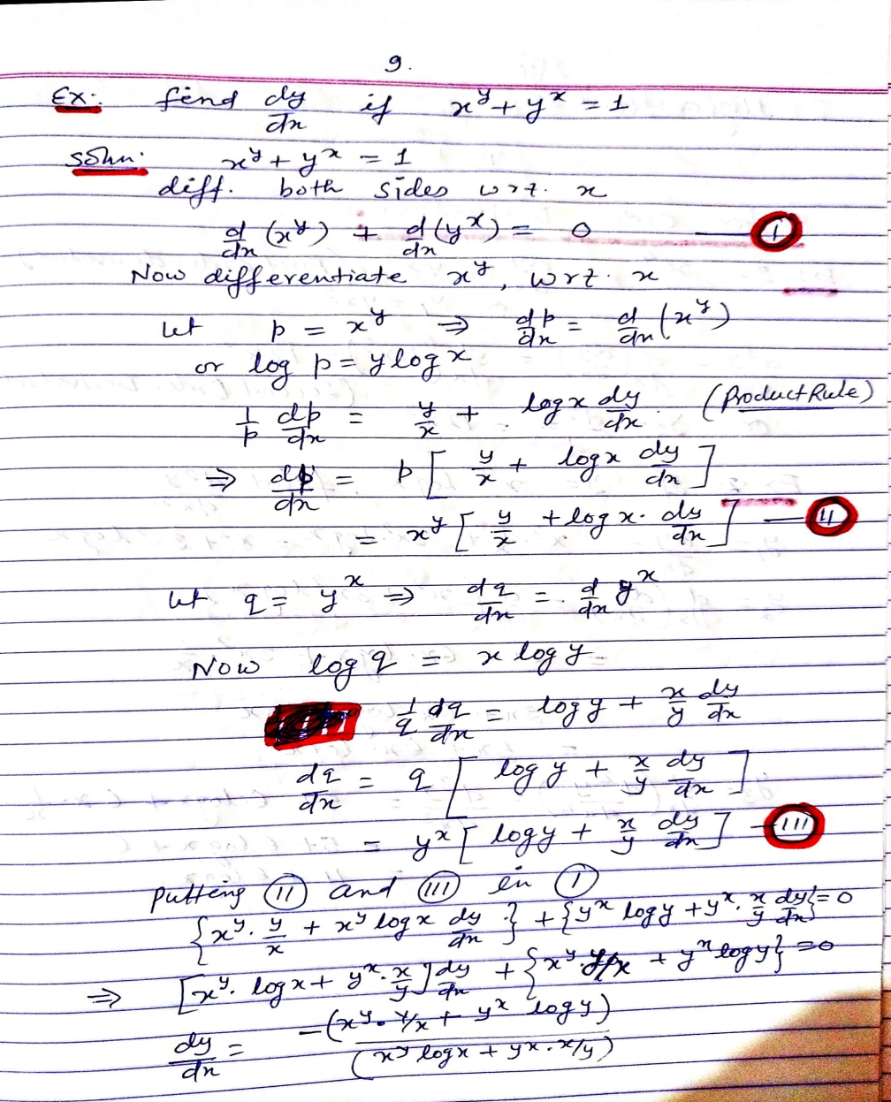

Slide 11
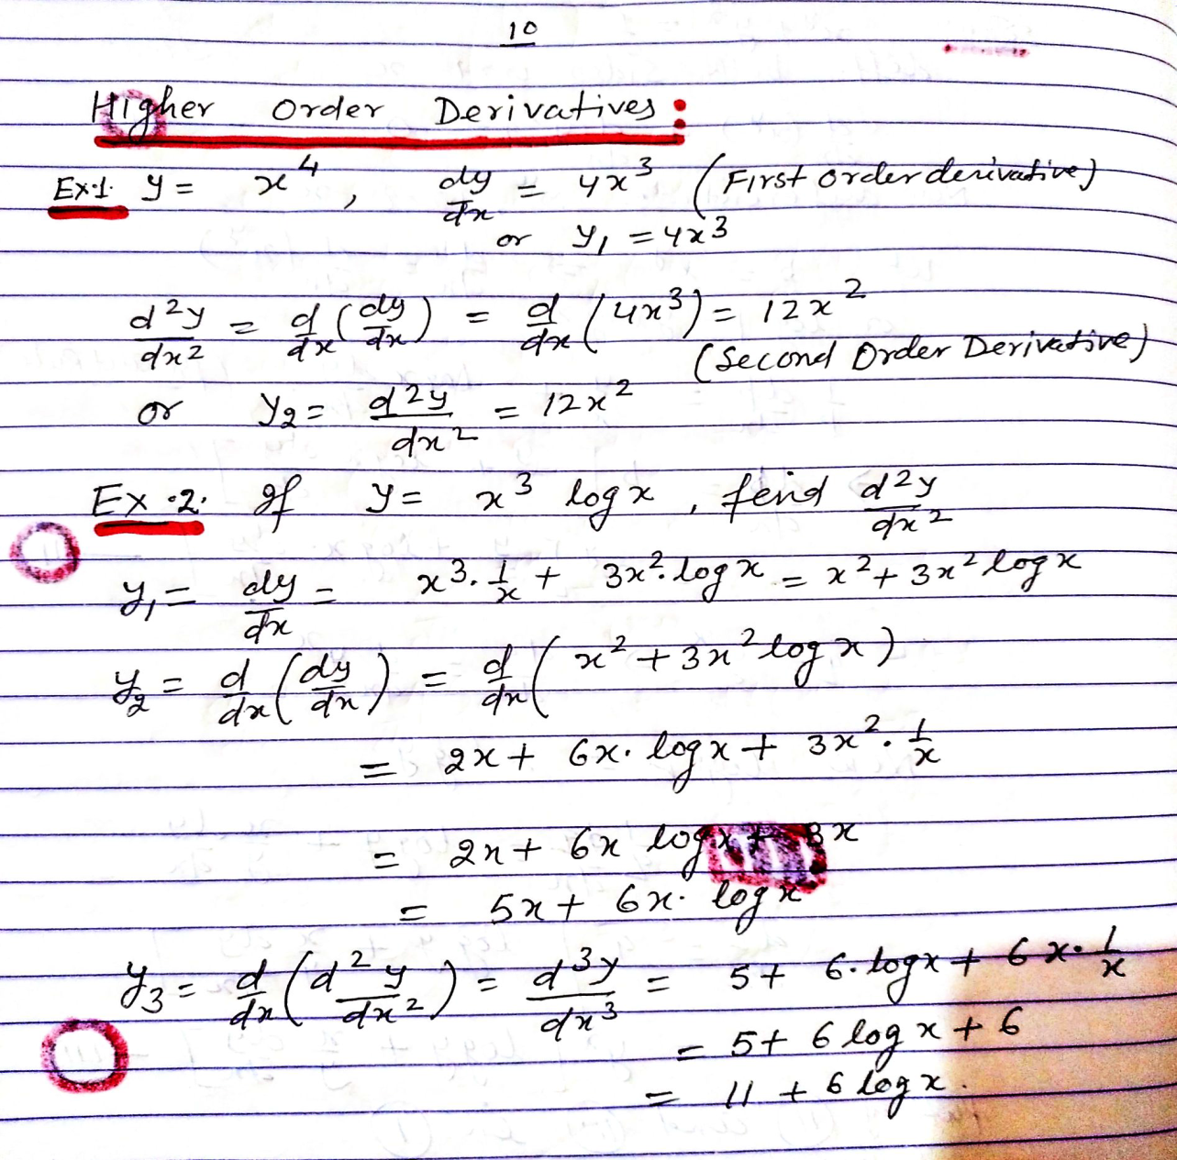

Slide 12
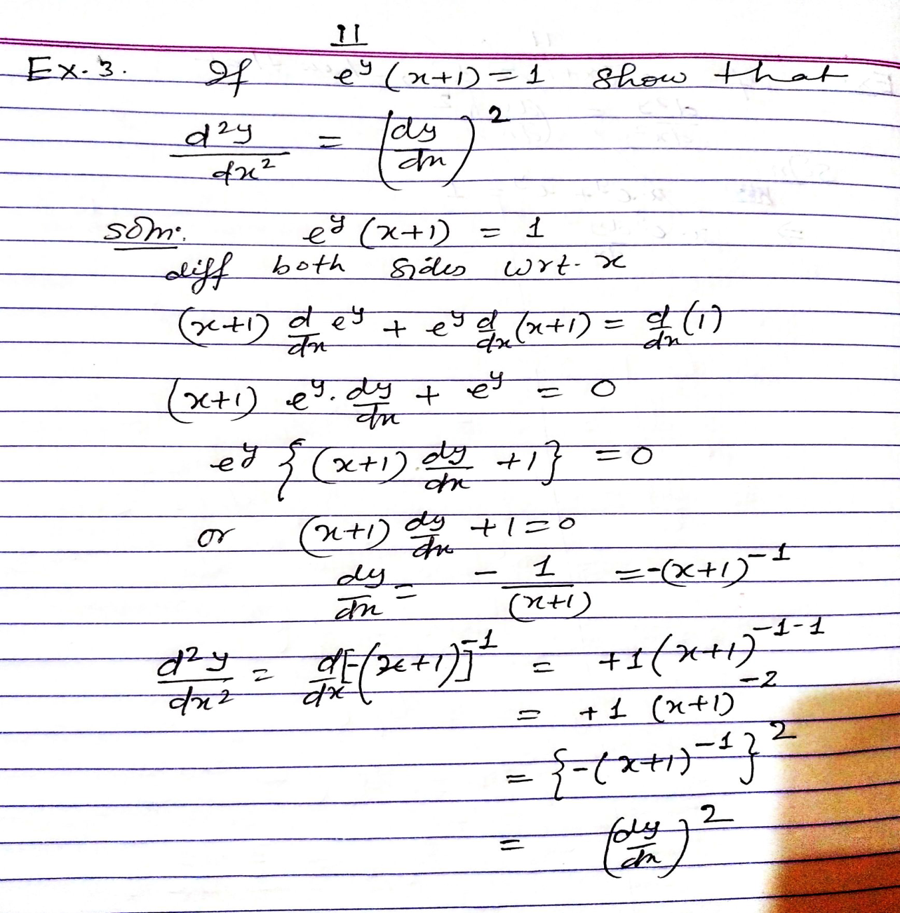

Slide 13
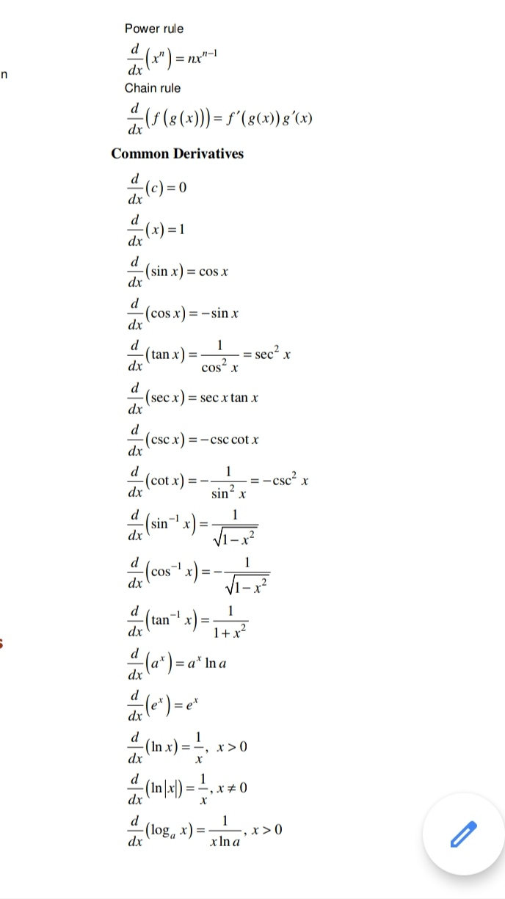
Important formulae

Slide 14
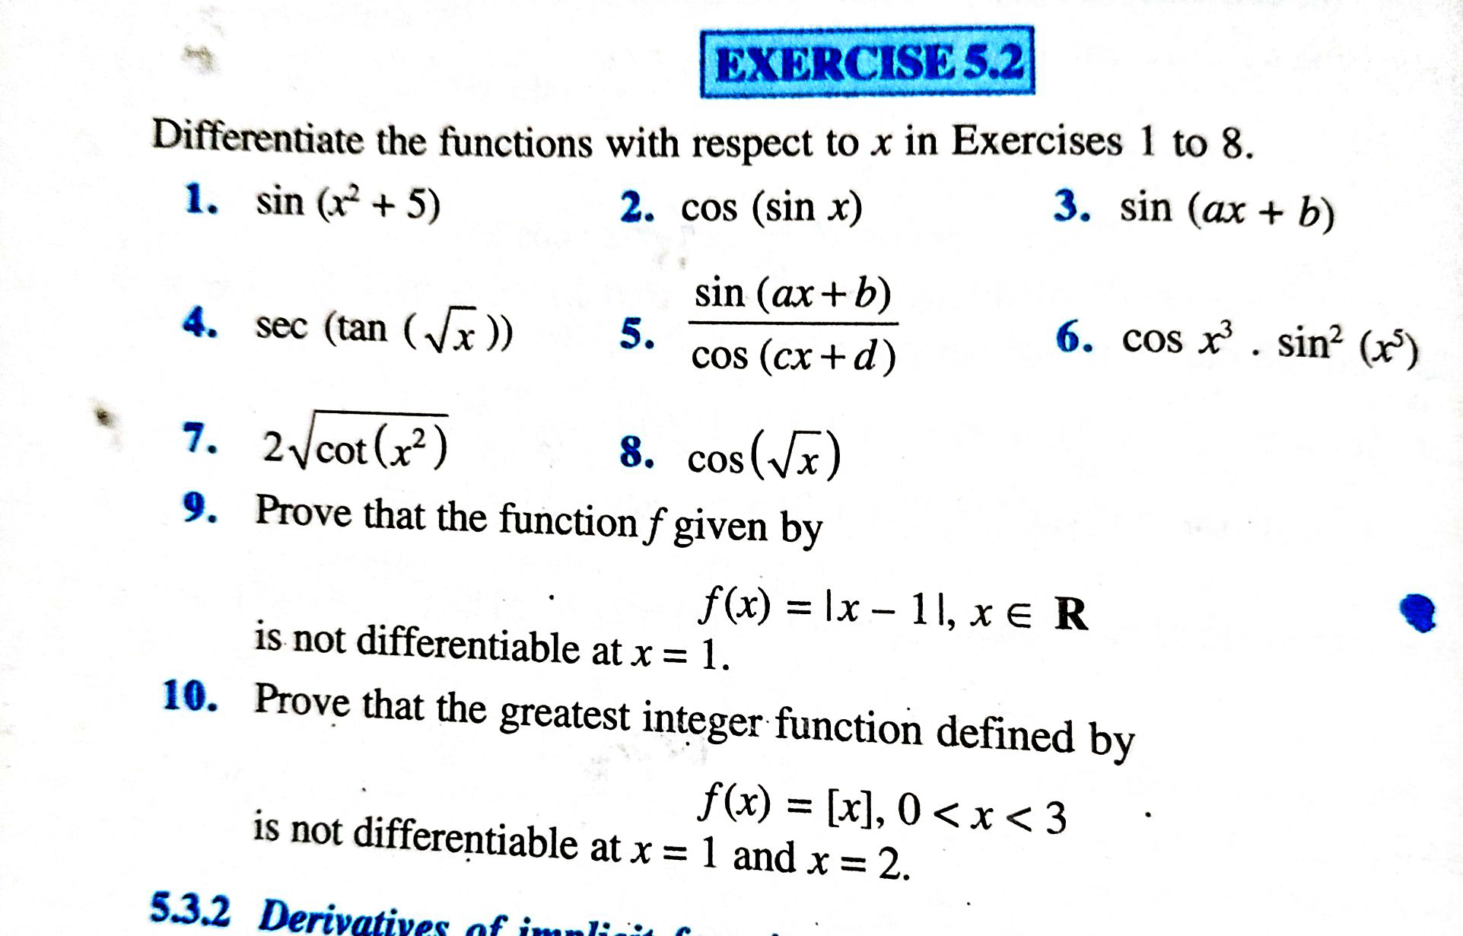
Practice Questions

Slide 15
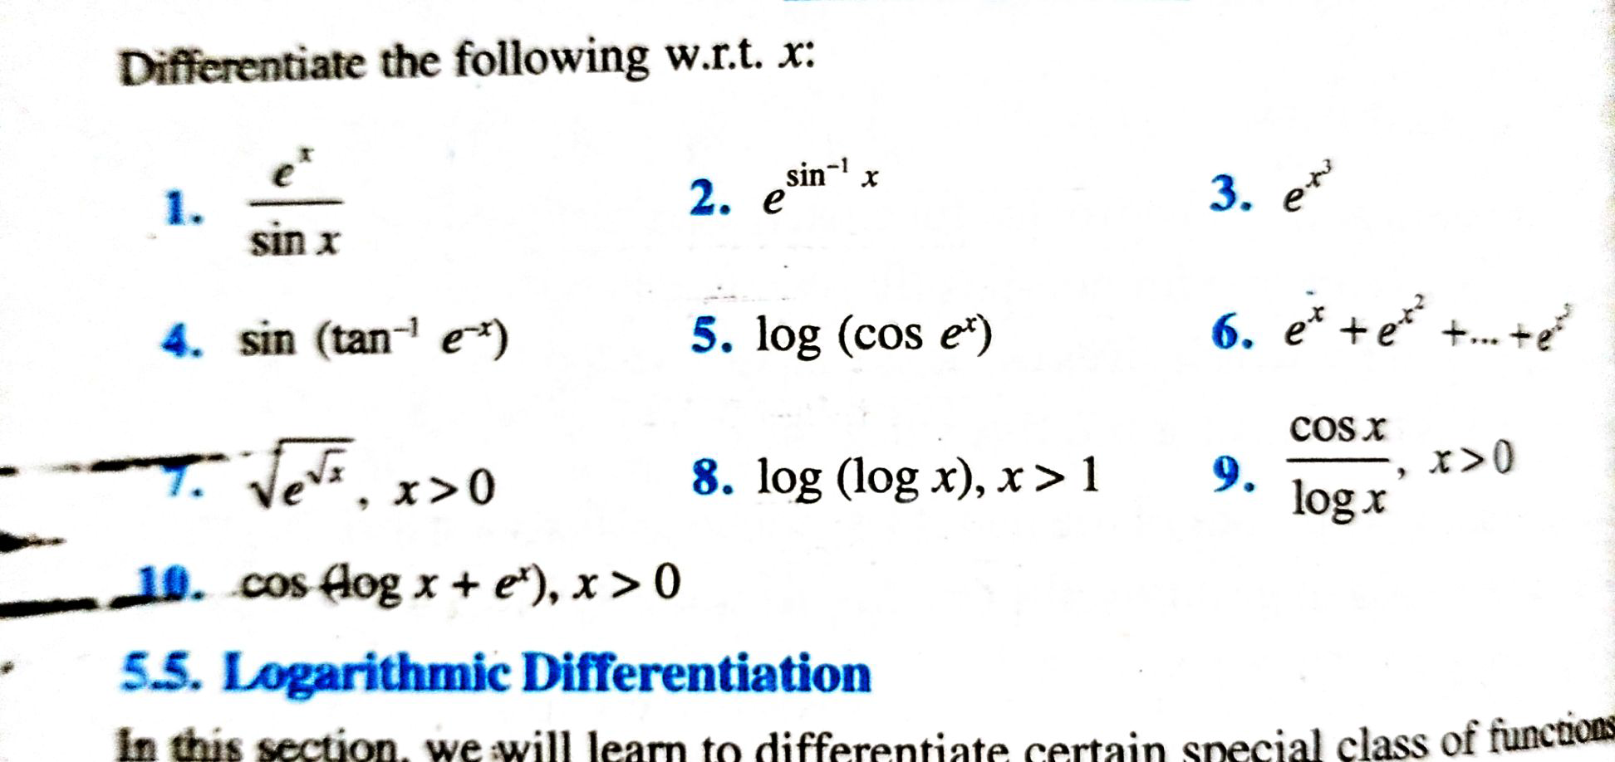
Practice Questions

Slide 16
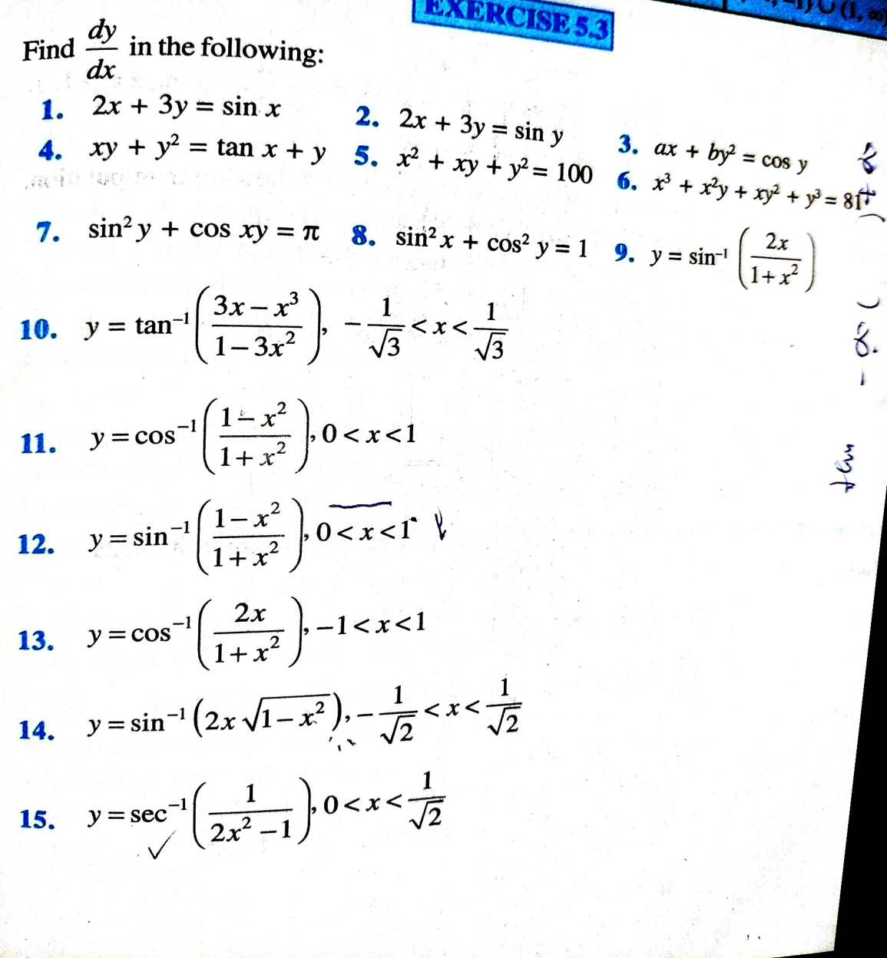
Practice Questions

Slide 17
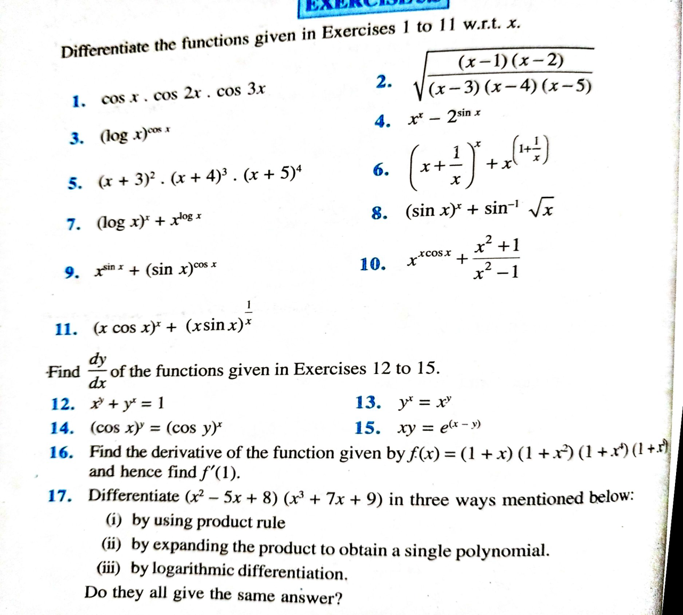
Practice Questions

Slide 18
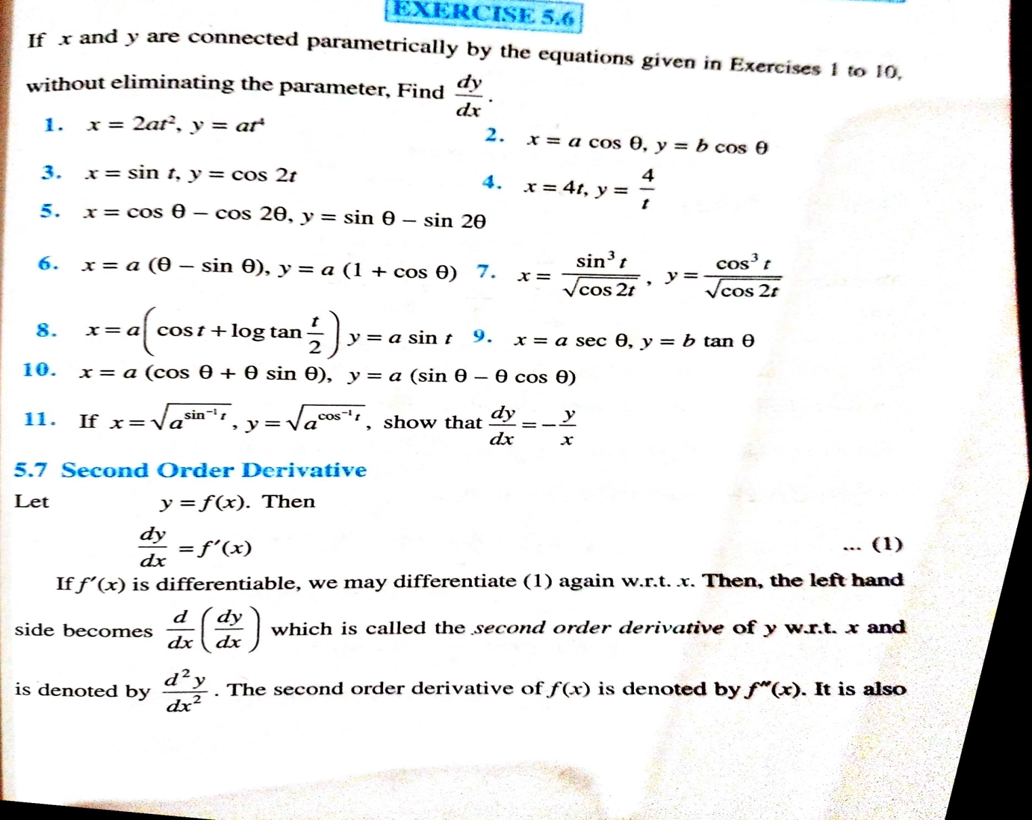
Practice Questions

Slide 19
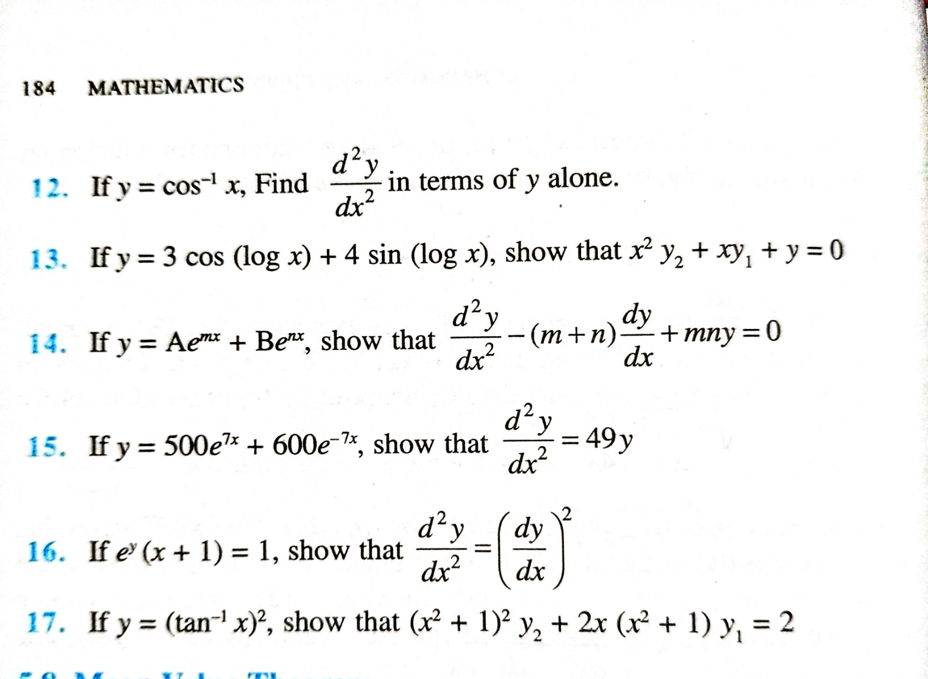
Practice Questions

Slide 20
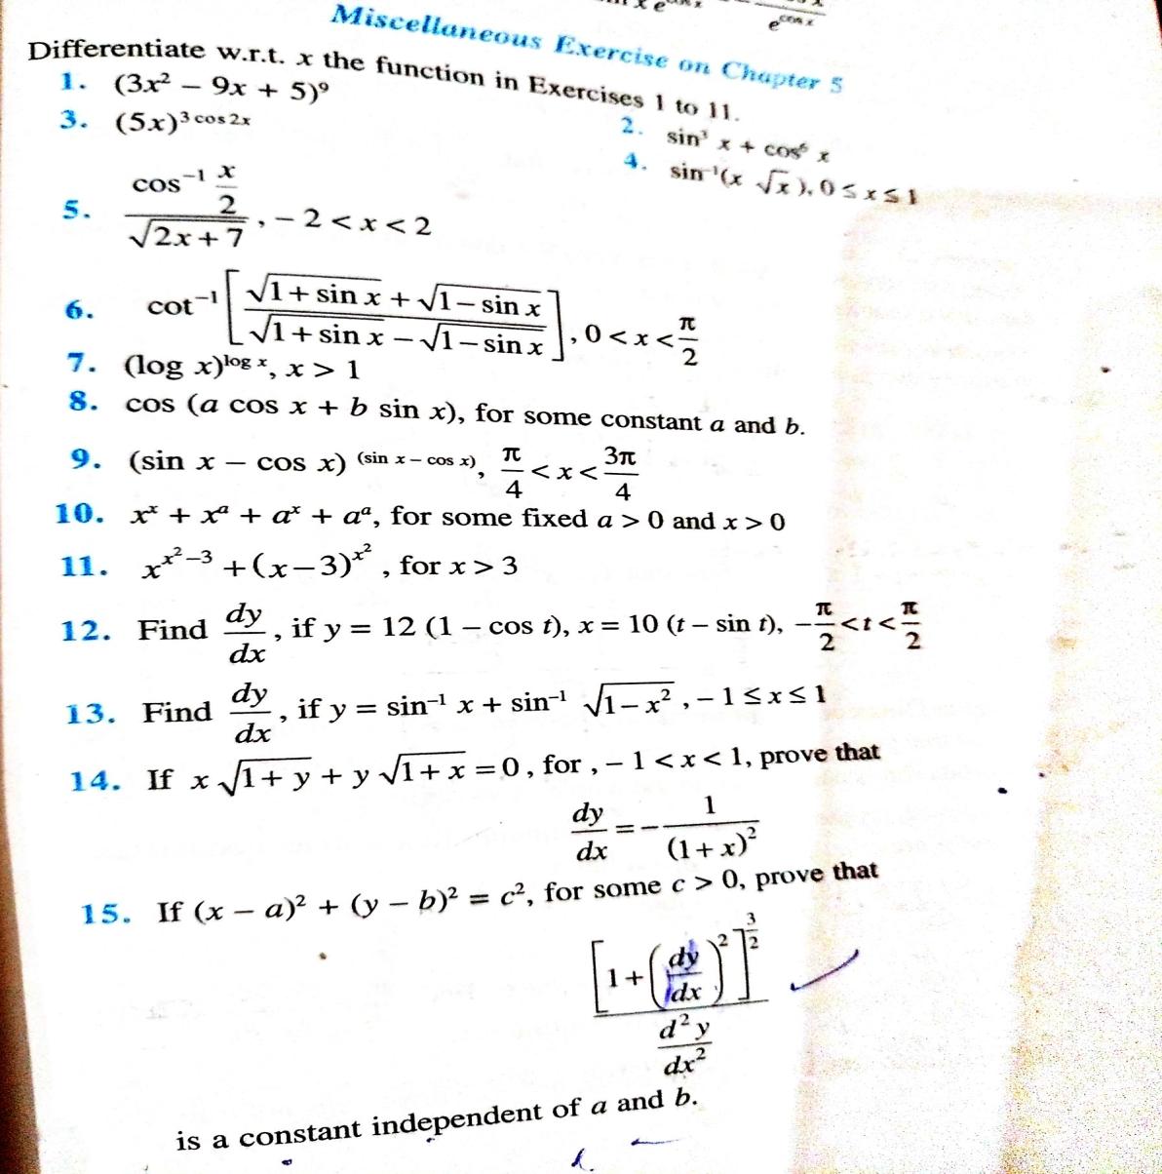
Practice Questions

